Slide 2
Future of Finance
Tamer Amin Director , Digital Trust
11.2018
The Arab Federation of Accountants & Auditors
www.pwc.com/digital
Strictly private and confidential

Slide 3
Table of Contents
I. PwC point of view on Next Generation Finance
II. Planning for the Next Generation of Finance – what are others doing?
III. Next Generation Finance use cases

Slide 4
Evolution of Finance
Finance organizations are struggling to define what will be needed to succeed in a digital world
Evolution of Finance
Digitally enabled processes and data provide real time settlement and information
Drastic change in finance service delivery model
New finance skills required to compete
Future-2025
Next Generation
Finance
Today
Generation III
Greater demands for business and financial insights and analyses
More complex processes moved to shared services and outsourcing
RPA and Cloud becoming mainstream
Business Value
Manage fundamentals (cost & spending) as primary role
Multi-process shared services; optimize processes for low cost
Core ERP systems capability
2000s
Generation II
Early
1970s
Generation I
Manage book-keeping & accounting as primary role
Focus on securing and managing capital and expertise finance functions (treasury, tax)
Centralize internal processes
Time

Slide 5
Evolving business models and digital processing capabilities will drastically change the traditional finance and accounting model
Exploding Data Volumes
Accelerated
M&A
B2B to B2C
Business Models
Changing
Regulations
Industry
Convergence
Radical
Automation
Finance
Unstructured Data
Structure
Headcount
Skills
Processes
Systems

Slide 6
Finance must understand the impact of the digital world on it’s operations and operating model
Big data & analytics
Real-time computing
Mobility
Visualization
Which ones?
Robotics
How?
Artificial intelligence
Where?
Cloud
Why?
Machine learning
Blockchain
Speech recognition

Slide 7
Next Generation Finance 101
Today’s Finance methods, structures and systems were designed to support analog or discrete processes. Tomorrow’s Next Generation Finance model will:
Be digitally enabled and focused on speed
Integrate and analyze information on a real time basis
Transact events as they occur
Dramatically reduce the cycle time of all finance activities and the size of finance
Require a new level of skills to remain competitive
Notes:
Actuary: or in general
RPA can play a role in
Data acquisition (from multiple sources)/information search
Data Validation checks
Population of models
Calculate rules based models
Creation of entries based on results

Slide 8
Finance 2025 - the art of the possible
The Future CFO getting a caffeine fix
3:00am
3:15am
3:30am
6:00am
6:01am
6:02am
Inventory and Revenue transactions populated by an automated robot feed to the finance data lake
Dashboards and Gross Margin bridge reports are automatically prepared by Therapeutic Area using interactive visualization tool
Commentary is added leveraging natural language generator (NLG) to the bridge reports and dashboards
CFO gets in line at Starbucks
CFO queries Gross Margin analysis for APAC using iPhone voice recognition software
CFO orders double latte – pays using digital currency
CFO reviews bridge mobile dashboard report and commentary on iPhone
CFO asks iPhone to drill down on APAC Gross Margin by product
CFO utilizes voice recognition software to initiate alert to APAC commercial team for follow up discussion on commentary
CFO receives Starbucks double latte

Slide 9
Next Generation Finance will reduce the size of Finance by 50% and require a dramatic shift in Finance skills & capabilities
Current state headcount
Future state headcount
Analytics
Insight
& action
Insight & action
Process mining
Reporting & compliance
Cloud
Reporting & compliance
Transaction processing
Blockchain
Transaction processing
Robotics

Slide 10
Key characteristics of a Next Generation Finance Model
Insight & action
Reporting & compliance
Transaction processing
“Siri” based on-demand insights
>1,000x data available for analysis
Deep business knowledge needed to interpret AI and business analytics
Dynamic portfolio investment scenario modeling
Real-time analytics – anywhere
Plug-and-Play integration
Transition from accounting focus to business events
Accelerated SEC/Statutory/ Tax filings
Continuous audit
Instant Treasury/cash position visibility
Fraud/compliance analytics
Increased regulator transparency
Eliminate offshoring/ 75% headcount reduction
Real-time digital AP/AR settlement
Elimination of reconciliations
Virtual closing and consolidation
Shift to exception management
Distributed ledger
Digital Architects & Data Scientists will play key roles in Finance

Slide 11
“Digital Finance” is not just about tools
“Executives widely agree that the biggest obstacle to a successful digital transformation is not the technology, but rather, the ability to architect the changes required in the culture and people.”
Source: “2016 Gartner CEO and Senior Business Executive Survey”
PwC | Next Generation Finance POV

Slide 12
New skill sets and ways of working - the future Finance professional
Transformation
expertise
Comfortable
with disruptive
technology and
innovation
(technology)
Existing workforce
Transparency on existing skillset
Close the gap (training, coaching, community)
Personnel restructuring/ replacement
Liberated by
robotic and
artificial
intelligence
(process)
Share and
collaborate
across
boundaries
(information)
Different
aspirations,
career goals and
ambitions of
digital natives
(people)
New workforce
Bringing in new skills (data science)
Deal with different/new demands
Be aware of limited availability
New limitations
Assisted by
advanced decision-
making support
centers of
excellence
(organization)

Slide 13
Tomorrow’s changing landscape will demand data science and analytical skills
23%
Graduates will have deep data science and analytics skills
69%
Of employers say they will prefer job candidates with deep data science and analytical skills over ones without
Data science and analytics skills, by 2021
How will employers fill the talent pipeline?
Student supply
Employer demand

Slide 14
Digital finance – Operating differently within Finance and with the business
Business Partner
FP&A
Transactional Accounting
General Accounting
Specialist Functions (tax, treasury)
Core Finance Technical competencies (mapped to roles)
Business acumen
Driving business value & performance
Influencing business decisions
Application of business modelling
Investment value creation
Business acumen
Driving business value & performance
Influencing business decisions
Application of business modelling
Investment value creation
Sophisticated modeling/ analytics
Sets global standards for financial planning and analysis
Influencing business decisions
Business acumen
Process improvement
Sophisticated modeling/ analytics
Sets global standards for financial planning and analysis
Influencing business decisions
Business acumen
Process improvement
Lean process and automation
System functionality
Managing controls
Adapting to new business models / acquisitions
Vigilant data governance
Lean process and automation
Exception Management
Managing controls
Adapting to new business models & acquisitions
Vigilant data governance
Accounting judgement
Lean process and automation
System functionality
Managing controls
Adapting to new business models & acquisitions
Specialist knowledge
Business acumen
Driving business value and performance
Influencing business decisions
Lean process and automation
System functionality
Managing controls
General functional competencies (relevant for all roles)
People management
Process improvement
Guarding Business Integrity
Project and Change Management
Guarding business integrity
Project and change management
People Management
Process Improvement
Leadership competencies (if applicable)
Focus on customers
Create innovative solutions
Lead change
Inspire by example
Drive operational excellence
Deliver results
13

Slide 15
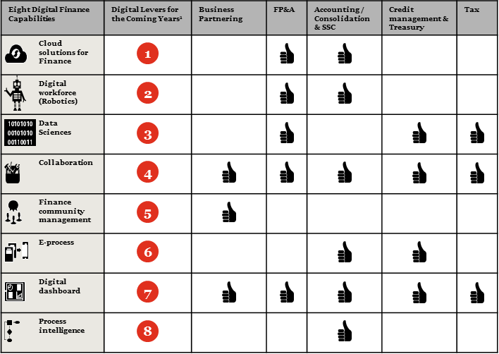
PwC survey results of key digital capabilities
1) Ranking based on the gap between current and future state
Source: PwC CFO Survey 2017 – 400+ Finance Professionals

Slide 16
Workforce of the future considerations
In a digital economy, temporary, flexible finance and accounting jobs are commonplace and companies will utilize independent contractors and freelancers instead of full-time employees
40%
34%
Workforce is not employed in traditional full-time 9 to 5 jobs
On-demand workers such as Uber drivers, Instacart delivery, TaskRabbit
85%
30%
New jobs between 2007 to 2017 were alternative or non-traditional
Payroll costs savings to employers when they hire freelancers
91M
35%
By 2025, percentage of Next Generation Finance and Accounting workforce without traditional Finance and Accounting degrees
1099-MISC tax forms issued by the IRS in 2016

Slide 17
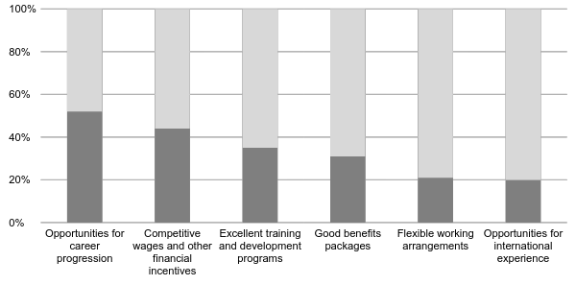
Assessing and attracting talent
Critical Factors to Being an Attractive Employer for an Evolving Workforce
52%
44%
35%
31%
21%
20%
*PwC NextGen study
16

Slide 18
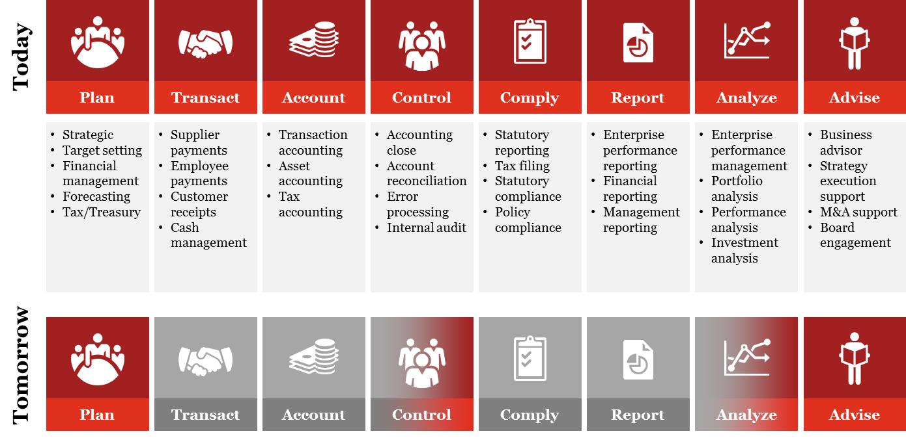
Finance focus shift in the Next Generation Digital World
Today
Tomorrow
Finance focus
Automated and digitized

Slide 19
Next Generation Finance will be enabled by the following capabilities and supported by a Digital Foundation that transacts and reports in real time
Workforce
The future finance workforce will be much smaller and more agile with greater analytical skills
Collaboration
Trading partners and stakeholders will be connected to your digital finance model
DIGITAL
FOUNDATION
(real-time processing integrated with analytics)
Process
Intelligent finance processes will enable real time processing
Data and Analytics
Real-time analytics will be supported by a digital data model

Slide 20
Finance organizations are launching efforts to prepare for the Next Generation Finance world
People
Data
Technology
Process
Structure
Educating and training workforce on digital capabilities
Increasing digital awareness and fitness
Defining digital data model
Conducting Blockchain POCs
Implementing data lakes and visualization tools
Deploying cloud solutions
Implementing SAP S4 HANA as digital hub
Simplify and standardize global processes
Deploying RPA solutions.
Analyzing service delivery models and capabilities
Rethinking shared service and outsourcing strategies
PwC | Next Generation Finance POV

Slide 21
Next Generation Finance use cases
Focus Area
Description
Impact
Implemented QlikView to analyze key components of gross margin reporting
Automated data flows and developed bridge visualization reports showing budget to actual drivers
Drivers included FX, Price, Volume, Geographic Mix
Over 150 users across the globe providing timely analysis and visuals of key therapeutic and product margin
Response times for Finance to deliver value-added analysis dropped by 80%
Reduction of 12 resources supporting data flows, systems and manual reporting
Reporting Automation and Visualization
Complex data model with disparate ERPs, master data elements and hierarchies, including vendor, customer, product, accounts
Launched effort to standardize data model based on leading practices in order to prepare for common digitization
Automate data between multiple sources in real-time manner
Enhanced global reporting across multiple dimensions
Reduced support and data reconciliation effort
Enhanced visibility of cradle to grave ROI analysis for R&D
Digital Data Model

Slide 22
Next Generation Finance use cases
Focus Area
Description
Impact
Manually intensive planning process and platforms with an extended planning cycle lacked capabilities to understand business drivers
Multiple planning platforms across the company contributed a lengthy cycle of manual data reconciliation and controls
Migrated company to a single instance of a leading cloud EPM platform to automate planning processes and provide transparency to business drivers
FP&A Cloud
Consolidated 4 planning instances to 1 reducing IT and Finance support by 65%
Standardizing process and data models simplified the overall planning reducing cycle time to 3 months
Transparent business drivers improved Finance’s ability to provide insight
Developed finance capabilities framework outlining key skills required to support next generation finance model
Assessed and prioritized key skills required to deliver finance needs in a digital world
Began to develop and deliver skills and training curriculum for finance professionals
Clear roadmap of future state finance capabilities and required training
Capabilities improvement for finance team
Finance Capabilities

Slide 23
Next Generation Finance use cases
Focus Area
Description
Impact
Highly manual, non-standardized process caused organization to have a very high AP processing cost. Additionally, due to lack of automation in the AP the company was missing out on significant early pay discounts
Organization considered several alternatives to reduce costs including migrating to an offshore shared service center
Organization decided to improve the technology in AP including leveraging RPA to automate standard, recurring activities
Reduce cost to process an AP invoice by over 50%
Improved ability to take advantage of negotiated discounts by 40% saving company $1.5mm per year
Robotic Process Automation - AP
Numerous RPA projects launched throughout Shared Services, FP&A and corporate accounting
Lack of consistent RPA tools, approach, business case, and benefits
Established RPA COE to gain consistency across all RPA initiatives
Formalized governance and support model for finance RPA initiatives
Allow finance organization to prioritize RPA efforts based on key benefits and impact
Standardized RPA methodology, applications, and support model
Attain faster ROI on RPA programs
Robotic Process Automation - COE

Slide 24
Next Generation Finance
50% reduction in F&A headcount
Daily settlement of AP and AR
No reconciliations
Finance data scientists vs. Transaction processors
Process managers resolve exceptions
Embedded compliance and control
Automated audit
Elimination of shared services and F&A outsourcing

Slide 25
Finance cost levers
The levers necessary to achieve productivity and cost reduction in Finance are usually clear to many companies
1.2% of Revenue
Transformation of the Finance Function
Corporate
Examples of Value Drivers
0.8% of Revenue
Corporate
Streamlined legal entity structures
Redefine role of corporate finance
Merge functions
Improve spans of controls
Create accountable Centers of Expertise
Business Units
Business Units
Rationalize P&L points (countries, legal entities, product lines)
Reduce/standardize reports for performance management
Leverage self-service
Simplify budgeting/forecasting reducing frequency & detail
Use standard ERP functionality and reporting tools
Simplify intercompany allocations and transfers
Costs
Back-Office
Shared Services or Outsourced
Standardize back-office processes
Streamline and centralize close processes
Automate low-value manual work
Consolidate globally across businesses
Adopt offshore delivery models
Aggressively resource existing contracts
Harmonize data structures and technology platforms
Back-Office
Shared Services
2010
2018

Slide 26
Our learnings from Finance cost reduction and productivity initiatives
In our experience successful Finance cost reduction and productivity initiatives require business units to “play” to capture the high-end of benefits
Three Categories of Finance Opportunities
Requires redesign or coordination that extends across the Finance function, (e.g., consolidate transaction processes, consolidate deal management, restructure project resources)
45%
Requires changes in the corporate and business unit operating model to achieve results (e.g., change business partner support model and reporting lines, simplify forecasting/flash process, streamline mgmt. reporting, simplify country P&Ls)
30%
3
Requires Effort that Extends Beyond Finance
(Inherent)
2
Typically achieved by changing local processes or policies (e.g., implement P-Card, Consolidate Payroll, Reduce Invoice Customization)
Requires Finance-Wide Effort (Structural)
Up to 30% of finance savings
Requires changes in the Business
Operating Model
25%
1
Can be Done Locally or within Specific Functions (Systemic or realized)

Slide 27
Typical automation focus areas
Operational Accounting
Procure to Pay
General
Accounting
Financial
Reporting
Management
Reporting
Planning and
Forecasting
Governance &
Compliance
Internal Audit
Treasury
Capital Mgmt & Investments
Tax Planning &
Accounting
Investor
Relations
Operational Accounting
Loan Accounting
Consolidation
Financial Reporting
Segment/profit
center reporting
Strategic Planning
SOX Compliance
Risk & Control Framework
Global Economics
Capital Strategy
Tax Accounting / Tax data mgmt
Stakeholder ID and Analysis
Loan Accounting
Exp Acc & Reimbursement
FM Product Control
Vendor Administration
Legal entity master data maintenance
Regulatory Reporting
Product Profitability
Annual Budget
Finance Master Data Gov.
Internal Functional Audit
Bank Relations
Capital Planning
Tax accounting / Analysis
Stakeholder engagement
Securities pricing
Requisitions & PO Processing
Journal Entry Processing
Statutory Reporting
Customer
Profitability
Quarterly / Rolling Forecast
Accounting Policy & Gov.
Consultation
FX Management
Capital Structure and Asset level
Tax accounting / Preparation
Stakeholder relations
Billing & Collection
Accounts Payable
Allocations & Adjustments
Audit Support
Cost Accounting / allocations
Process controls
Liquidity Management
Acquisitions & Divestitures
Tax compliance
Corporate Comms
Accounts Receivable
Strategic Sourcing
Reconciliations
Analytics &
Decision Support
Regulatory Policy & Gov.
Cash Management
Business Case Support
Tax Planning
Rating Agency Relations
Fixed Asset Accounting
Payroll
Inter-company Transactions
Ad hoc Reporting
Tax & Treasury Policy
Debt / Equity Management
Project Accounting
Tax controversy / tax audits
Equity Investments Accounting
Contract Negotiations
Legal Entity Closing
Funds Transfer
Pricing
Treasury Strategy
Target for automation

Slide 28
Thank you!
© 2018 PwC. All rights reserved. PwC refers to the US member firm or one of its subsidiaries or affiliates, and may sometimes refer to the PwC network. Each member firm is a separate legal entity. Please see www.pwc.com/structure for further details.

