Slide 1


Slide 2
IFRS 16 Leases

Slide 3
The $3 trillion standard
“One of my great ambitions before I die is to fly in an aircraft that is on an airline’s balance sheet…”
Sir David Tweedie
April 2008
“Listed companies are estimated to have US$3.3 trillion of lease commitments, over 85% of which do not appear on their balance sheets…”
Hans Hoogervorst
January 2016

Slide 4

Why is it important to understand IFRS 16?
    Most companies lease assets and will be affected by the standard
    Under IFRS 16, lessees will bring leases on balance sheet
    Significant changes in key reporting metrics due to an increase in reported assets and liabilities.
    Many judgemental issues.
    Controversial standard that your stakeholders/investors will want to understand the impact on your business.

Slide 5
Overview of the model: Lessor vs lessee
“Risks and rewards” model
“Right-of-use” model
Lessor
Right to use leased asset
Lessee
Underlying asset
Right-of-use asset
Consideration
(lease rentals)
Substantially all risks and rewards of ownership transferred?
Recognise “right-of-use” asset
Recognise liability to pay rentals
Finance lease
Operating lease
All significant leases on-balance sheet for lessees with expense recognition generally front-loaded, similar to current finance leases

Slide 6
What has changed for lessees?
Changes to lessee accounting
    Former operating leases capitalised
    All¹ leases accounted for similarly to today’s finance leases
      ROU asset and lease liability recognised
      Depreciation of all ROU assets
      Interest expense for all lease liabilities
Balance sheet
Income statement
Cash flow statement
  Leased assets
  Financial liabilities
  Equity
  Operating expense
  Finance cost
  Depreciation
  Operating outflows
  Financing outflows

Slide 7
Sir David Tweedie’s aircraft
%
Five year lease of an aircraft
CU1,000,000 per annum due at 31 Dec
No renewal no purchase option
Discount
rate: 7%
Aircraft useful life: 20 years

Slide 8
Journal entries
1 January 20X1 | Debit (CU) | Credit (CU)
ROU asset (present value of 5 x CU1,000,000 @ 7%) | 4,100,000
Lease liability |  | 4,100,000
31 December 20X1
Depreciation expense (CU4,100,000/5) | 820,000
ROU asset |  | 820,000
Interest expense (CU4,100,000 * 7%) | 287,000
Total P&L expense | 1,107,000
Lease liability | 713,000
Cash |  | 1,000,000

Slide 9
Impact on P&L – IFRS 16 vs IAS 17
ASSUMPTIONS:
10 YEAR LEASE
RENT OF $100,000 PER ANNUM
DISCOUNT RATE OF 7%
RENTAL EXPENSE UNDER CURRENT STANDARD
Total lease expense will be front-loaded even when cash rentals are constant
Notes:
No longer recognise rental expense under IAS 116, will see interest exp and dep instead
Highest exp will be in the earlier years (highest in the first year, lowest in the last year) – aka front-loading of exp.
Although cash outflow is the same, P&L will be volatile

Slide 10
Lease liability amortisation
 | Balance at beginning of the year | Interest | Payment | Balance at end of the year
T0 | $702,358 | $0 | $0 | $702,358
T1 | $702,358 | $49,165 | $100,000 | $651,523
T2 | $651,523 | $45,607 | $100,000 | $597,130
T3 | $597,130 | $41,799 | $100,000 | $538,929
T4 | $538,929 | $37,725 | $100,000 | $476,654
T5 | $476,654 | $33,366 | $100,000 | $410,020
T6 | $410,020 | $28,701 | $100,000 | $338,721
T7 | $338,721 | $23,710 | $100,000 | $262,432
T8 | $262,432 | $18,370 | $100,000 | $180,802
T9 | $180,802 | $12,656 | $100,000 | $93,458
T10 | $93,458 | $6,542 | $100,000 | ($0)
Notes:
Diff between interest exp and cash payment is the repayment of the LL balance. Similar to what we would recognise for a financing arrangement

Slide 11
Impact on balance sheet – IFRS 16 vs IAS 17
Balance sheet under current IAS 17 | Inception | Year 1 | Year 2 | Year 3 | Year 4 | Year 5 | Year 6 | Year 7 | Year 8 | Year 9 | Year 10
Assets | - | - | - | - | - | - | - | - | - | - | -
Liabilities | - | - | - | - | - | - | - | - | - | - | -
Balance sheet under IFRS 16
Right of use asset | $702,358 | $632,122 | $561,887 | $491,651 | $421,415 | $351,179 | $280,943 | $210,707 | $140,472 | $70,236 | $0
Lease liability | (702,358) | (651,523) | (597,130) | (538,929) | (476,654) | (410,020) | (338,721) | (262,432) | (180,802) | (93,458) | $0
Net Equity | $0 | (19,401) | (35,243) | (47,278) | (55,239) | (58,841) | (57,778) | (51,724) | (40,030) | (23,222) | $0
Companies with operating leases will appear to be more asset-rich, but also more heavily indebted
Notes:
Under IAS 17, if I only have operating leases – no impact on BS
But under IAS 116 now, there will be a net liability position for the company. A lot of companies raised opinions about this new standard – operationally challenging and brings about a sig. financial impact

Slide 12
Impact on Income statement – IFRS 16 vs IAS 17
 | Year 1 | Year 2 | Year 3 | Year 4 | Year 5 | Year 6 | Year 7 | Year 8 | Year 9 | Year 10
Income statement under IAS 17
Operating lease expense | 100,000 | 100,000 | 100,000 | 100,000 | 100,000 | 100,000 | 100,000 | 100,000 | 100,000 | 100,000
Income statement under IFRS 16
Amortization expense | $70,236 | $70,236 | $70,236 | $70,236 | $70,236 | $70,236 | $70,236 | $70,236 | $70,236 | $70,236
Interest expense | $49,165 | $45,607 | $41,799 | $37,725 | $33,366 | $28,701 | $23,710 | $18,370 | $12,656 | $6,542
Total expense | $119,401 | $115,842 | $112,035 | $107,961 | $103,602 | $98,937 | $93,946 | $88,606 | $82,892 | $76,778

Slide 13
Impact on cash flow statement – IFRS 16 vs IAS 17
 | Year 1 | Year 2 | Year 3 | Year 4 | Year 5 | Year 6 | Year 7 | Year 8 | Year 9 | Year 10
Cash flows as per IAS 17
Operating cash flows | (100,000) | (100,000) | (100,000) | (100,000) | (100,000) | (100,000) | (100,000) | (100,000) | (100,000) | (100,000)
Cash flows under IFRS 16
Cash flow from financing activities | (50,835) | (54,393) | (58,201) | (62,275) | (66,634) | (71,299) | (76,290) | (81,630) | (87,344) | (93,458)
Cash flow from financing/operating | (49,165) | (45,607) | (41,799) | (37,725) | (33,366) | (28,701) | (23,710) | (18,370) | (12,656) | (6,542)
Total cash outflow | (100,000) | (100,000) | (100,000) | (100,000) | (100,000) | (100,000) | (100,000) | (100,000) | (100,000) | (100,000)

Slide 14
Effective date
Effective date
1 January 2019
Annual report
31 December 2019
2016
2017
2018
2019
Mar
June
Sep
Dec
Early adoption permitted
if IFRS 15 is adopted
Interim reports

Slide 15

The new definition of a lease

Slide 16
Lease definition
Identified asset
+ =
Control over use
Lease
A contract is, or contains, a lease if the contract conveys the right to control the use of an identified asset
Notes:
Lease definition is now the test that determines whether an arrangement is on- or off-balance sheet for a customer / lessee.
Explain that the lease definition consists of three key elements:
Identified asset: explicitly specified in a contract or implicitly specified at the time it is made available for use by lessee. Contract relating to maintenance of an asset – is there an identified asset?
Economic benefits: lessee must obtain substantially all of the economic benefits. This is a change for some IFRIC 4 arrangements which will be discussed later.
Direct the use: most difficult part, can be highly judgemental

Slide 17
Lease definition – Control over use
Control over use
Determined through
Right to obtain substantially all of the economic benefits
Right to direct the use

Slide 18
Definition of a lease
Based on which party controls the use of an identified asset
    Customer has right to control: lease
    Supplier has right to control: service
Right to direct the use of the asset
Customer has the right to control if it has BOTH:
AND
Right to obtain substantially all economic benefits from use the asset

Slide 19
Identification of a lease contract
Contract does
not contain
a lease
Identified asset?
No
Yes
Lessee obtains substantially all
of the economic benefits?
No
Yes
Lessee directs the use?
No
Yes
Contract is or contains a lease
No
Notes:
If the answer to any of these questions is a yes, then a lease exists and the ROU asset and lease liability has to be calculated

Slide 20
Is there an identified asset?
Is an asset explicitly specified in the contract?
Further analysis (see next slide)
Yes
No
Is an asset implicitly specified in the contract?
Yes
No
No identified asset

Slide 21
Substantive substitution rights
Practical ability of lessor to substitute asset throughout the period of use?
Could be identified asset
Yes
Yes
Lessor benefits economically from substitution?
Yes
Yes
No identified asset
Notes:
Can lessor make decisions to change the asset with another similar one? AND
Does lessor benefit from the substitution?
If yes to both, there’s no identified asset

Slide 22
Capacity portions
Physically distinct
Not physically distinct:
Substantially all of total capacity?
Yes
No
Can be identified asset
No identified asset
Notes:
Briefly discuss the leasing of data from a Telco company – Modem is installed on lessee’s premises (identified asset exists) but does lessee obtain substantially all of the total capacity that the modem transmits?

Slide 23
Identification of a lease contract
Identified asset?
No
Contract does
not contain
a lease
Yes
Lessee obtains substantially all
of the economic benefits * ?
No
Yes
Lessee directs the use?
No
Yes
Contract is or contains a lease
No
* Economic benefits = Primary output, by-products and other economic benefits that could be realised commercially

Slide 24
Identification of a lease contract
Identified asset?
No
Contract does
not contain
a lease
Yes
Lessee obtains substantially all
of the economic benefits?
No
Yes
Lessee directs the use?
No
Yes
Contract is or contains a lease
No

Slide 25
Directing the right to use
Who takes the ‘how and what purpose’ decisions
throughout the period of use?
Customer
Predetermined
Supplier
Customer operates asset or directs others to do so
Customer designed asset
Other
Contract is or contains a lease*
Contract does not contain a lease
Protective rights of the supplier
* If other criteria are met.
Notes:
Protective rights – present in leasing of premises. Usually termed as prohibitions, “tenant not allowed to use for any other purpose besides office rental” (KKH 17, SGH 21, JHS 1, Hyflux 2, NUHS 8)
Explain that when determining who directs the right to use of the identified asset the most important decisions are considered. These are the so called ‘how and what purpose decisions’ that determine the output.
Consider for example who decides:
What is produced by the asset.
When it is produced.
Where it is produced.
Whether it is produced.
If the customer makes the ‘how and what purpose decisions’ then the contract is a lease.
Conversely, if the supplier makes those decisions then the contract is not a lease, but a service contract.
When the ‘how and what purpose decisions’ are predetermined the classification is more complex and depends on further considerations:
There can be a lease if the customer operates the asset or directs others to do so or designed the asset.
In all other cases there is no lease.

Slide 26
Shipping contract – does customer direct the use?
Customer enters into a two year contract with supplier to transport cargo from China to Australia.
The ship is explicitly specified in the contract, supplier has no substitution rights.
Cargo will occupy substantially all of the capacity of the ship.
Identified
asset
Economic benefits
Directing the right to use
?

Slide 27
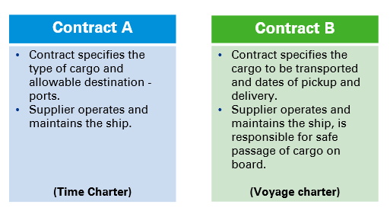
Measuring the right-of-use asset
    Which contracts are lease contracts?
Contract A
Contract B
Both

Slide 28
Recap
Identified asset?
No
Contract does
not contain
a lease
Yes
Lessee obtains substantially all
of the economic benefits?
No
Yes
Lessee directs the use?
No
Yes
Contract is or contains a lease
No
Notes:
If the answer to any of these questions is a yes, then a lease exists and the ROU asset and lease liability has to be calculated

Slide 29
Definition of a lease
    Example fact pattern: Equipment
    3 year contract for Customer to use a piece of equipment
    Supplier has 50 identical pieces of equipment
    Supplier can substitute the equipment for an identical piece at any time and is required to substitute if the equipment breaks down or otherwise needs replacing
    In all other respects, Customer controls the equipment during the lease term
    Is this a lease?

Slide 30
Definition of a lease
    Example fact pattern: Storage facility
    10 year contract for Customer to use a storage facility
    Supplier deals with transporting items for storage to and from the facility
    Customer decides what will be stored at any time and instructs Supplier accordingly
    As well as the fees for use of the facility for 10 years, Customer pays a further fee based on Supplier transportation and other related costs
    Is this a lease?

Slide 31
Definition of a lease
    Key question for implementation:
Has very much changed compared to today?

Slide 32
Lease and non–lease components
If a contract is, or contains, a lease, then the company accounts for each separate lease component, separately from non-lease components.
Step1: Identify the components
A company considers the right to use an underlying asset as a separate lease component if it meets the following criteria:
Can the customer benefit from the using the underlying asset either on its own or together with other resources that are readily available?
Is the asset neither highly dependent on, nor highly inter-related with, the other assets in the contract?
+
Yes
No
Separate components
Combine components
Notes:
- Highly dependent/inter-related – highly judgmental area
To discuss provision of maintenance/repair/cleaning services of office rental – Hyflux can benefit from the use of office space w/o the provision of additional services. Office space is not highly inter-related to the provision of service – thus, separate components (KKH 17, SGH 21, Hyflux 2)

Slide 33
Lease and non – lease components (cont’d)
Step 2: Account for the components
 | Lessee | Lessor
Observable stand-alone price for each component | Unless practical expedient is elected, separate and allocate based on the relative stand-alone price | Always separate and allocate following the IFRS 15 approach
No observable stand-alone price for some or all components | Maximize the use of observable information
Taxes, insurance on the property and admin costs | Activities that do not transfer a good or service to the lessee are not components in a contract
Practical expedient | Combine lease and any associated non-lease components and account for them as lease components | N/A

Slide 34
Definition of a lease
    Key question for implementation:
Has very much changed compared to today?

Slide 35
Lessee accounting

Slide 36
Single lease accounting model
Leases on balance sheet
Balance sheet
P&L
Cash flows statement
Asset
Lease expense
Operating
= ‘Right-of-use’ of
underlying asset
Depreciation
= Interest*
+ Interest
* Choice by entity
Liability
= Front-loaded total lease expense
Financing
= Obligation to make lease payments
= Interest*
= Principal repayments
Notes:
Under IAS 116 there is only a single lease accounting model – the ‘right of use (ROU) model’ where all leases are accounted for on-balance sheet. Lessee now recognises:
A new asset representing the ROU of the underlying asset.
A new liability representing the obligations to make payments over the term of a lease.
Changes on the balance sheet figures will now flow through the P&L. Lease expenses will now be driven by those new assets and liabilities. A lessee will now recognise:
A depreciation expense of the ROU asset - typically calculated on a straight-line basis; and
An interest expense due to the new lease liability, as if it were the interest on any other mortgage - higher in the earlier years than in the later years.
Total lease expense will be higher in the earlier years than in the later years, even if the cash payments are constant each period.
The geography of the expenses under IAS 116 is different. Under IAS 116, lease expense is presented as interest and depreciation expense rather than as operating expense. Hence, the lessee’s EBITA (earnings before interest, tax and amortisation) will be higher.
In the cash flow statements, the cash flows from financing will be higher given that the principal repayment of lease liability is reflected as part of financing cash flows instead of operating cash flows.
- Dep is a non-cash item, introduction of interest expense and principal repayments vs IAS 17 where cash paid out relates directly to lease exp

Slide 37
Exemptions for lessee
Two major optional exemptions make the standard easier to apply
Short term leases
Leases of low value items
≤ 12 months
≤ USD 5,000 (suggested)
Election by class of assets
Election on lease by lease basis
    When exemption is applied, recognize the expense on a straight line basis over the lease term.
Notes:
Exemption has to be applied on a consistent basis for the Group
Short term asset – If there’s a purchase option in a 1 year lease, the exemption does not apply.
Low asset value – has to be the cost of the asset when it is NEW and available for sale (i.e. computers, tablets, office furniture)

Slide 38
Leases of low-value assets
Absolute basis of assessment
    B4: Different leases are expected to reach the same conclusions
Components
    B3: Not highly dependent on, or highly interrelated with, other assets

Slide 39
Short-term leases
    Example fact pattern:
    1 year lease commencing 1 January 2019
    Contract contains 9 extension options for a further year; exercisable at 31 December each year
    At 1 January 2019, the lessee concludes that it is not reasonably certain to exercise any extension options, and uses the short-term lease exemption
    What happens in subsequent years if the extension options are exercised?

Slide 40
Leases of low-value assets
    Example fact pattern:
    Big Company and Small Company both have a very high volume of leased office desks, all of which meet the definition of a low-value asset when assessed individually.
    Big Company:
    Has a lot of property on its balance sheet
    Having assessed materiality, Big Company doesn’t capitalised any PPE with a cost of less than US$15,000
    Small Company:
    Is in the service industry and has relatively few assets
    Having assessed materiality, Small Company capitalizes PPE with a cost of more than US$100

Slide 41
Measuring the lease liability
Lease liability
Present value of lease rentals
Present value of expected payments at end of lease
=
+
Key inputs
Lease term
Lease payments
Discount rate

Slide 42
Lease term
Non-cancellable period
+
Lease term
=
Optional renewal periods if lessee reasonably certain to exercise
+
Periods after optional termination date if lessee reasonably certain not to exercise
    Similar concept as IAS 17, lease term should include optional periods to the extent it is reasonably certain that the lessee will exercise the option to extend (or not to terminate) the lease.
Notes:
Lease term is the first key input when measuring the lease liability – very important and relevant for Hyflux . Office rental lease, data centre lease, land lease from govt contain renewal options. Does Hyflux have significant economic incentive to renew the contract? More often than not, YES.
Explain the periods to be included in the lease term:
Non-cancellable period: the period over which a lease contract creates enforceable rights and obligations.
Options to renew or terminate the lease contract whenever the lessee is reasonably certain to exercise these options (key judgment).
Highlight the concept of ‘reasonably certain’ is crucial to determining the ‘lease term’ and the ‘lease payments. ‘Reasonably certain’ is a high threshold of probability that must be met to include optional lessee payments in the measurement of lease assets and lease liabilities.
An entity assesses whether a lessee is reasonably certain to exercise or not to exercise an option by considering all economic factors relevant to that assessment: contract-based, asset-based, market-based and entity-based factors.
Explain the significance of determining lease term: under IAS 116, an additional year of lease term implies an additional year of liability to be recognised.

Slide 43
Lease term: Key considerations
    Two key questions for implementation:
Has very much changed compared to today?
What does “reasonably certain” mean?

Slide 44
Lease term – economic factors
Contractual/market
Asset
Level of rentals in secondary period compared to market rates.
Contingent payments.
Renewal and purchase options.
Costs relating to the termination of the lease and the signing of a new replacement lease.
Returning costs of the underlying asset.
Nature of item (specialised).
Location.
Availability of suitable alternatives.
Existence of significant leasehold improvements.

Slide 45
Variable lease payments
Which variable lease payments are included in the lease liability?
Payments based on an index or rate
Payments based on turnover or usage

Slide 46
Variable lease payments: Based on an index or a rate
    Recap:
    Re-measure only when there is a change in cash flows
Initially measure based on index or rate at the commencement date
Do not forecast future changes in the index or rate

Slide 47
Variable lease payments: Based on sales or usage
    Recap:
Are the lease payments genuinely variable?
Don not include in the lease liability; Recognise in P&L when incurred
Is there an amount which is unavoidable for the lessee?
Not genuinely variable
Include in lease liability

Slide 48
Variable lease payments: Based on sales or usage
    Example 3:
    10 year lease of a retail store
    Lease payments are 10,000 per year, plus 5% of sales
    Forecast sales are 500,000 per year
    Ignoring discounting, what is the lease liability on initial measurement?
    zero
    100,000
    350,000

Slide 49
Variable lease payments: Based on sales or usage
    Example 3:
    10 year lease of a retail store
    Lease payments are 10% of sales
    Forecast sales are 500,000 per year
    Ignoring discounting, what is the lease liability on initial measurement?
    zero
    50,000
    500,000

Slide 50
Discount rate
Interest rate implicit in the lease
Lease payments
Fair value of underlying asset
Residual value at end of lease
Lessor’s initial direct costs
Use of this rate can be readily determined by the lessee

Slide 51
Discount rate
If the rate implicit in the lease cannot be readily determined by the lessee
    USE
Lessee’s incremental borrowing rate
    Rate of interest that a lessee would have to pay to borrow over a similar term, and with a similar security, the funds necessary to obtain an asset of a similar value to the right-of-use asset in similar economic environment.

Slide 52

Discount rate
What about long term leases of property?
What is “similar” when I could never get a 20 year loan??

Slide 53
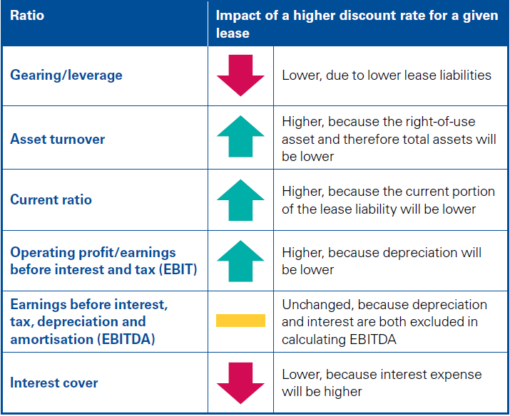
Impact of discount rate on lease liability

Slide 54
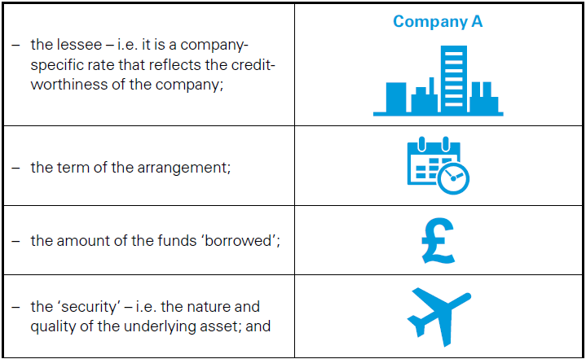
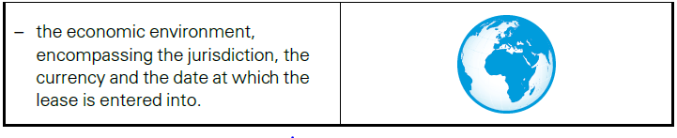
Factors relevant while determining the Incremental borrowing rate

Slide 55
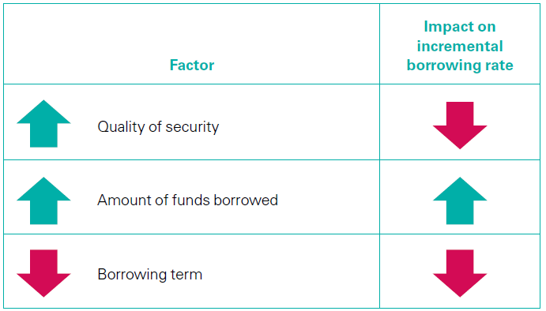
Impact of the factors on the incremental borrowing rate

Slide 56
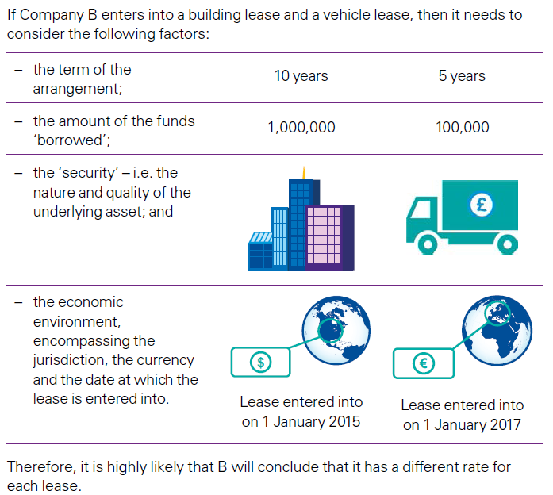
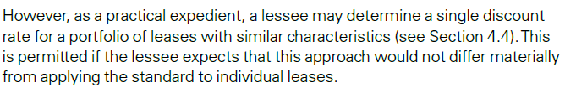
Example - incremental borrowing rate

Slide 57
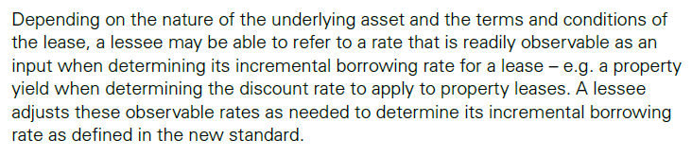
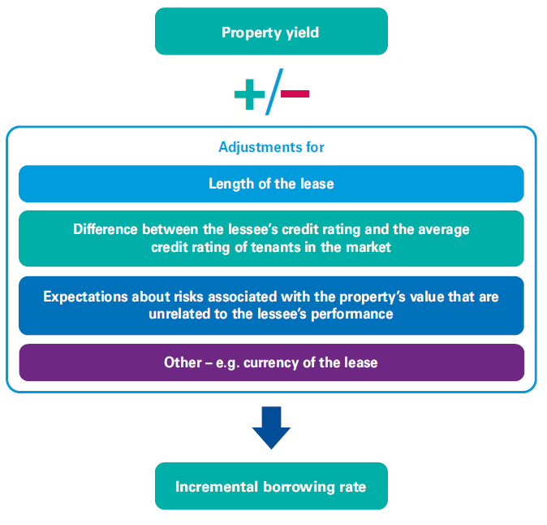
Discount rate -Adjustments to observable rates

Slide 58
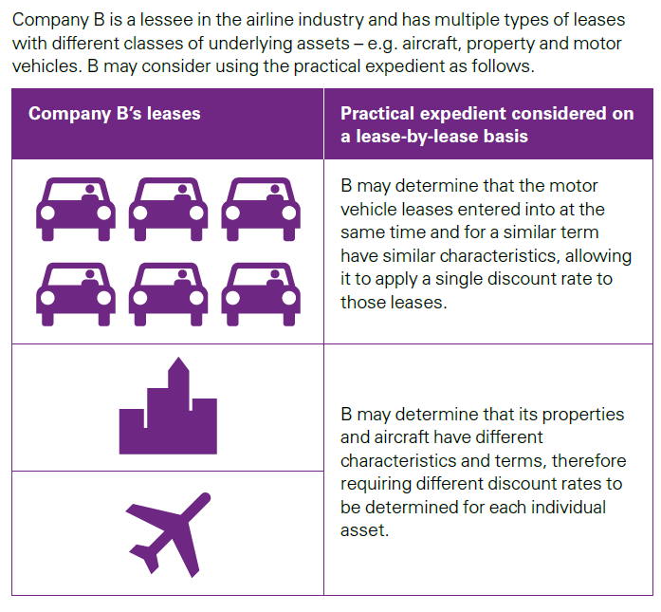
Transition options

Slide 59
Subsequent measurement
Lease liability
Amortised cost using the effective interest method.
ROU asset
(cost model)
Depreciated in accordance with IAS 16 Property, Plant & Equipment.
Depreciation period is the shorter of lease term/useful life.
Impairment testing under IAS 36 Impairment.
ROU asset
(alternative models)
Revaluation model under IAS 16.
Fair value model under IAS 40 Investment Property.

Slide 60
Subsequent measurement - lease liability
Amortised cost using the effective interest method; no fair value option
Changes in carrying amount of lease liability due to:
Reassessment of lease term, purchase option and residual value guarantee
Reassessment of variable lease payments depending on an index or rate
Variable lease payments not depending on an index or rate
Lease modifications that are not separate leases
Relates to future periods
Relates to current periods
Adjust right-of-use asset*
Recognise in profit or loss
Discount rate
Lease term
Purchase option
*If the carrying amount of the right-of-use asset is reduced to nil, then any further reductions are recognised in profit or loss
Notes:
Introduce the slide and note that many clients will be interested in understanding which of the changes on subsequent measurement of the lease liability will impact the profit or loss or will adjust the ROU asset.
Say that reassessments of the lease term, purchase option and residual value guarantees will adjust the ROU asset and that if the ROU asset would be zero – (because the ROU asset is totally impaired or fully depreciated at that point) the remeasurement amount will be recognised in the profit or loss.
Say that variable lease payments not depending on an index or rate (such as payments depending on a percentage of sales or usage) are recognised directly into the profit or loss as previously covered on initial measurement.
Note that reassessments of variable lease payments depending on an index or rate or in-substance fixed payments that related to the current period will as well be recognised directly in the profit or loss while the ones related to future payments adjust the ROU asset.
Lessee modification – refer to slide 63

Slide 61
Measuring the right-of-use (ROU) asset
IFRS 16 does not specify whether the ROU asset is tangible or intangible
ROU
asset
=
Lease liability
Initial direct costs
Prepaid lease payments
Costs to dismantle or restore
(IAS 37)
Lease incentives

Slide 62
Lessee accounting - lease modifications
Change to the contractual terms and conditions
(excludes exercise of option included in original lease contract)
Increase in the scope
All other lease modifications
Decrease in the scope
At standalone price for increase
Not at standalone price
Separate lease
Adjust ROU asset
Adjust ROU/
gain or loss

Slide 63
Lessor accounting

Slide 64
Lessor accounting
Same as IAS 17
Different to IAS 17
Lease classification test
Finance lease model
Operating lease model
Definition of a lease
Sale-and-leaseback guidance
Sub-lease guidance
Accounting for lease modifications
Disclosure requirements
No symmetry between lessee and lessor accounting

Slide 65
Application issues

Slide 66
Intercompany leases
Lessor
Right to use leased asset
Lessee
Underlying asset
Right-of-use asset
Consideration
(lease rentals)
Substantially all risks and rewards of ownership transferred?
Recognise “right-of-use” asset
Recognise liability to pay rentals
Finance lease
Operating lease
No automatic elimination!
Receivable
PPE

Slide 67
Application issues with subleases
Head lessor
    Intermediate lessor
    Accounts for head lease and sublease as two separate contracts
    Classifies the sublease based on the ROU asset arising from the head lease
    Recognises lease assets and lease liabilities gross unless offset criteria met
    Recognises lease income and lease expense gross unless acting as agent
Original lessee/ Intermediate lessor
Sub-lessee
Sublease classification is based on ROU asset, not the underlying asset. More subleases will be classified as finance leases by sub lessor
Notes:
Intermediate lessor accounts for the head lease and the sublease as two separate contracts.
Note that the intermediate lessor classifies the sub-lease as either finance or operating based on the ROU asset arising from the head lease (rather than based on the underlying asset) which means that in more scenarios the sublease will be classified as finance lease.
Say that the intermediate lessor recognises lease assets and liabilities gross unless offset criteria under IAS 32 is met.
Say that the intermediate lessor recognises lease income and lease expense gross unless it is acting as an agent.
Company A owns the property of XYZ.
Co A entered into a master lease with Co B for 5 years to lease out Co A’s property by collecting fixed rental.
Co B rents out some spaces to restaurants and conference room to outsiders for more than 12 months.
Co B is the original lessee/intermediate lessor.
Current treatment under IAS 17 – Lease between Co A & Co B is an operating lease. Thus Co B recognizes the lease payments to Co A on a straight line basis in profit or loss.
Current treatment under IAS 17 – leases between Co B & tenants of restaurants & conference room are operating lease => lease income recognised on a straight line basis in profit or loss.
On transition to IAS 116, Co B (if decided to use the practical expedient to grandfather the lease definition), it will recognize ‘Right-of-use’ asset and lease liabilities in respect of the lease between Co B & Co A.
Dr Right-of-use asset
Cr Lease liabilities
On transition to IAS 116, Co B will use the lessor lease classification to determine whether the leases between itself and the tenants of restaurants & conference room are operating leases. Since the lease classification is unchanged from IAS 17, it is likely that such leases continue to be classified as operating leases. If so, then there is no change in the accounting treatment between IAS 116 & IAS 17.
On the other hand, assuming the lease between Co B and a lessee is classified as a finance lease, then Co B will de-recognise the right-of-use asset and in its place recognize a lease receivable. The difference between the ROU asset and the lease receivable is recognize in the profit or loss. Note that the lease liability to ART (head lessor) remains. See Illustrative Example 20 in IAS 116.
Co A owns the property of XYZ.
Co A entered into a master lease with Co B for 5 years to lease out Co A’s property by collecting fixed rental.
Co B rents out some spaces to restaurants and conference room to outsiders for more than 12 months.
Co B is the original lessee/intermediate lessor.
Under IAS 17, this is treated as operating lease.
In Co B’s book:
Recognise ‘Rights of use’ and lease liabilities
Dr Rights of use
Cr Lease liabilities
If it is treated as finance lease under IAS 17,
In Co B’s book:
Derecognise the rights of use
Dr Rights of use
Cr Lease liabilities
Dr Lease receivables
Cr Rights of use

Slide 68
Application issues- Sale and leaseback
Application of IFRS 15 when determining whether a sale has occurred.
Recognition by seller of its right to use the assets sold, together with its financial commitments to make payments for that use.
Sale and leaseback transactions will no longer provide
seller-lessees with a source of off-balance sheet financing.
Notes:
Intermediate lessor accounts for the head lease and the sublease as two separate contracts.
Note that the intermediate lessor classifies the sub-lease as either finance or operating based on the ROU asset arising from the head lease (rather than based on the underlying asset) which means that in more scenarios the sublease will be classified as finance lease.
Say that the intermediate lessor recognises lease assets and liabilities gross unless offset criteria under IAS 32 is met.
Say that the intermediate lessor recognises lease income and lease expense gross unless it is acting as an agent.
Company A owns the property of XYZ.
Co A entered into a master lease with Co B for 5 years to lease out Co A’s property by collecting fixed rental.
Co B rents out some spaces to restaurants and conference room to outsiders for more than 12 months.
Co B is the original lessee/intermediate lessor.
Current treatment under IAS 17 – Lease between Co A & Co B is an operating lease. Thus Co B recognizes the lease payments to Co A on a straight line basis in profit or loss.
Current treatment under IAS 17 – leases between Co B & tenants of restaurants & conference room are operating lease => lease income recognised on a straight line basis in profit or loss.
On transition to IAS 116, Co B (if decided to use the practical expedient to grandfather the lease definition), it will recognize ‘Right-of-use’ asset and lease liabilities in respect of the lease between Co B & Co A.
Dr Right-of-use asset
Cr Lease liabilities
On transition to IAS 116, Co B will use the lessor lease classification to determine whether the leases between itself and the tenants of restaurants & conference room are operating leases. Since the lease classification is unchanged from IAS 17, it is likely that such leases continue to be classified as operating leases. If so, then there is no change in the accounting treatment between IAS 116 & IAS 17.
On the other hand, assuming the lease between Co B and a lessee is classified as a finance lease, then Co B will de-recognise the right-of-use asset and in its place recognize a lease receivable. The difference between the ROU asset and the lease receivable is recognize in the profit or loss. Note that the lease liability to ART (head lessor) remains. See Illustrative Example 20 in IAS 116.
Co A owns the property of XYZ.
Co A entered into a master lease with Co B for 5 years to lease out Co A’s property by collecting fixed rental.
Co B rents out some spaces to restaurants and conference room to outsiders for more than 12 months.
Co B is the original lessee/intermediate lessor.
Under IAS 17, this is treated as operating lease.
In Co B’s book:
Recognise ‘Rights of use’ and lease liabilities
Dr Rights of use
Cr Lease liabilities
If it is treated as finance lease under IAS 17,
In Co B’s book:
Derecognise the rights of use
Dr Rights of use
Cr Lease liabilities
Dr Lease receivables
Cr Rights of use

Slide 69
Transition options

Slide 70
Applying the new lease definition
Companies can choose whether to:
Apply the new definition to all contracts
Apply a practical expedient to ‘grandfather’
or
Cost
Comparability
Cost
Comparability

Slide 71
Retrospective vs modified retrospective
Approach
2018
2019
Date of equity adjustment
Full retrospective
IFRS 16¹
IFRS 16
1 January 2018
IAS 17²
Modified retrospective
IAS 17
IFRS 16
1 January 2019³
¹ Comparatives in 2019 annual report will reflect balances under IFRS 16
² The 2018 Annual Report will reflect balances under IAS 17
³ The 2019 annual report will include an explanation of the differences between the balances recognised on transition to IFRS 16 and previously disclosed operating lease commitments

Slide 72
Former operating leases: Choice of transition approach
1) Cumulative catch-up approach
Do not restate comparative information
Adjust opening retained earnings on transition
Provide additional transition date disclosure
Optional practical expedient
Do not transition leases ending within 12 months
Simplified right of use asset measurement
Onerous lease provisions
Portfolio application
Use of hindsight

Slide 73
Cumulative catch-up approach
Comparative information is not restated
Data capture for IFRS 16;
C12 transition disclosures
IFRS 16
IAS 17
01/01/2018
31/12/2018
01/01/2019
31/12/2019

Slide 74
Cumulative catch-up approach
Simplified right-of-use asset measurement
available as a lease-by-lease choice
ROU asset = lease liability
Measure ROU asset retrospectively
OR
    No historic data required;
    ROU asset ‘too high’
    Most benefit for high-volume/low value leases
    Historic lease payment data required
    ‘Accurate’ ROU asset measurement
    Most benefit for individually significant leases

Slide 75
Effective date / early adoption
TODAY
13 Jan 2016
1 Jan 2017
1 Jan 2018
1 Jan 2019
IFRS 9
IFRS 16
Early adoption…?
Assess contracts once
Explain changes once
Only one year of significant change
Portfolio application
Time resources
IFRS 15

Slide 76
Modified retrospective – lease liability
Lease liability
Present value of remaining rentals
Present value of payments at end of lease
=
+
Discount at lessee’s incremental borrowing rate at date of initial application

Slide 77
Modified retrospective – ROU asset
Measurement options for ROU asset
Measure retrospectively using transition discount rate
Lease liability
+/- prepaid/accrued payments
‘Correct’ P&L
No historical information needed
Key benefit for individually significant leases
Key benefit for high volume, low value leases
Apply this option on a lease-by-lease basis

Slide 78
Optional practical expedients
PE#1
Account for leases expiring within 12 months as short term leases.
Lease liability
ROU asset
PE#2
Apply single discount rate to similar leases.
PE#4
Exclude initial direct costs from ROU asset.
PE#3
Use of hindsight e.g. determining lease term.
PE#5
Onerous contracts – adjust ROU asset.
*Modified retrospective approach only

Slide 79
Choosing a transition method
Significance
of change in accounting
Comparability of information and investor perceptions
Availability of historical information
Future
profit trends
Costs
Systems and processes
Contract
structure and volume of contracts
Disclosure requirements

Slide 80
Observations from ongoing projects

Slide 81
Impact on financial ratios
Profit/loss
Balance sheet
Ratios
EBITDA
Total assets
Gearing
EPS
Net assets
Interest cover
(in early years)
Asset turnover

Slide 82
Other impacts to consider
Uncertainty around operating leases remaining tax deductible?
Significant changes to accounting for subleases
Lessor and lessee accounting no longer consistent- will affect the consolidation process
Sale and leaseback arrangements are no longer off balance-sheet arrangements under IFRS 16

Slide 83
Effective date / early adoption
TODAY
13 Jan 2016
1 Jan 2017
1 Jan 2018
1 Jan 2019
IFRS 9
IFRS 16
IFRS 15
Early adoption…?
Assess contracts once
Explain changes once
Only one year of significant change
Portfolio application
Time resources

Slide 84
IAS 17: Operating lease commitments
IAS 17 finance lease liabilities at 31 Dec 2018
IFRS 16 lease liabilities at 1 Jan 2016
??
IAS 17 operating lease commitments (discounted) at 31 Dec 2018

Slide 85

Thank you

